Slide 1

EMOTION RECOGNITION USING MULTI-MODAL DATA
MSBA 326 - Machine Learning for Predictive analytics
Golden Gate University, San Francisco
Presenters:
Sumanth Ranga
Sai Teja Rekha
Hamsaveni
Hrushikesh Jadhav
Hisham Kochirikunnu

Slide 2
INTRODUCTION
- What is emotion recognition and why it matters
- Challenges of detecting emotions from single modalities
- Benefits of using multiple data types (text, audio, video, etc.)
Developing a real-time multimodal emotion recognition web app for text, sound, and video inputs
Notes:
What is Emotion Recognition and Why it Matters
"Emotion recognition is like teaching a computer to understand how we feel. It's important because it helps technology interact with us in a more human way. From improving mental health support to creating smarter customer service, recognizing emotions can make technology more helpful and empathetic."
Challenges of Detecting Emotions from Single Modalities
"It's tough for a computer to guess emotions from just text, sound, or video alone. Each one only tells part of the story, like trying to understand a joke without the punchline. Text lacks tone, sound lacks expression, and video lacks context. So, relying on just one can lead to misunderstandings."
Benefits of Using Multiple Data Types (text, audio, video, etc.)
"By using text, sound, and video together, we get a full picture of emotions, just like we do when we talk face-to-face. This multi-modal approach makes our system smarter and more accurate, catching the subtleties of emotions that might be missed otherwise."
Developing a Real-Time Multimodal Emotion Recognition Web App for Text, Sound, and Video Inputs
"We're trying to build a model that understands emotions in real-time, whether you're typing, talking, or on camera. This could change the way we interact with technology, making it more responsive and sensitive to how we feel in the moment."

Slide 3
EMOTION RECOGNITION MODALITIES
Text Modality
Sentiment analysis techniques using lexical resources
Stylistic features like punctuation, emoticons
Word embeddings to understand affective content
Audio Modality
Prosodic features: pitch, energy, speaking rate
Spectral features related to voice quality
Pretrained models like wav2vec 2.0
Visual Modality
Facial action units and facial landmarks
Deep learning on face images and video
CNN architectures like ResNet and MiniXception

Slide 4
MULTI-MODAL EMOTION DATASETS
Text: Go Emotions Dataset
Audio: RAVDESS datasets
Video: CK+, RAVDESS Dataset

Slide 5
MODELS FOR EMOTION RECOGNITION
A variety of machine learning techniques have been applied for emotion recognition from the different modalities:
Xgboost, CNNs and Transformers for sequence data like audio and text
CNNs for image classification on facial expressions
Neural networks can fuse features from different channels
Deep learning methods like CNN-RNN stacks have achieved state-of-the-art results by learning directly from raw data. Transfer learning using pretrained models is also effective.

Slide 6
MULTI-MODAL FUSION
Early, late, and hybrid fusion approaches
Feature-level and decision-level fusion techniques
Challenges: synchronization, dimensionality, missing modalities

Slide 7
EMOTION RECOGNITION USING IMAGE
Dataset used: CK+
Accuracy: 99.3 %

Slide 8
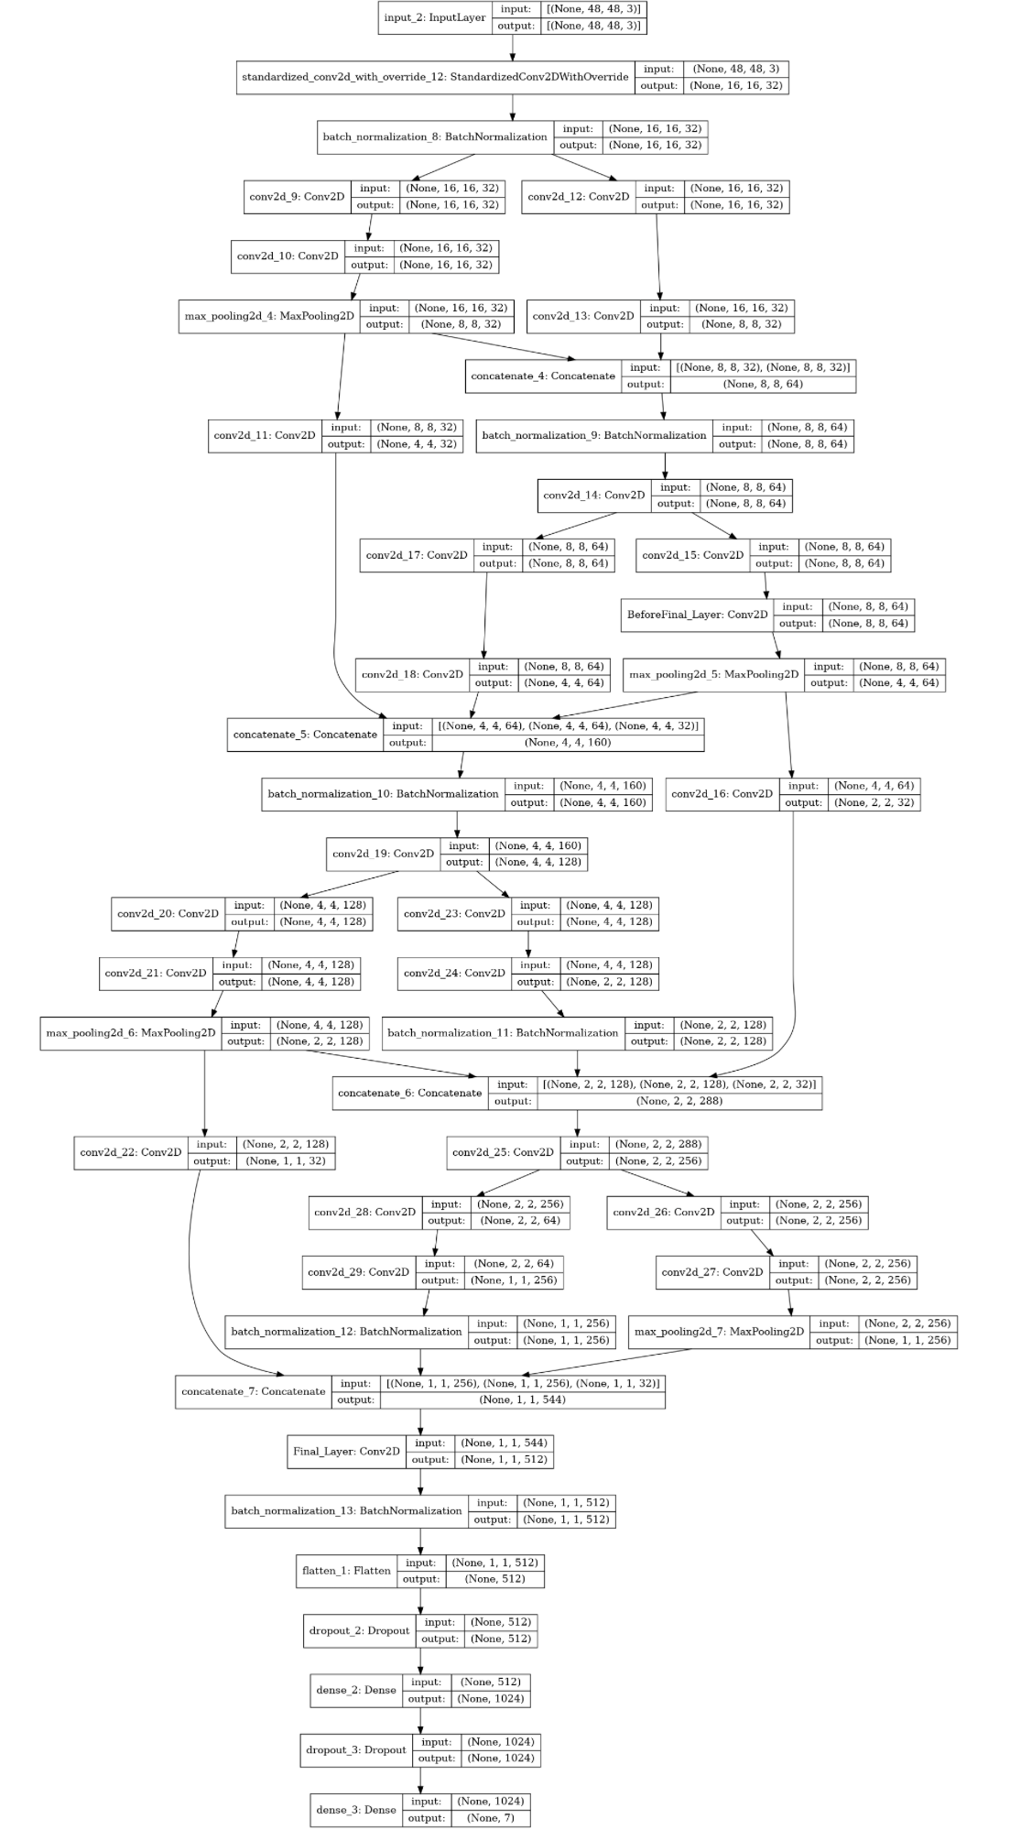
WORKFLOW

Slide 9
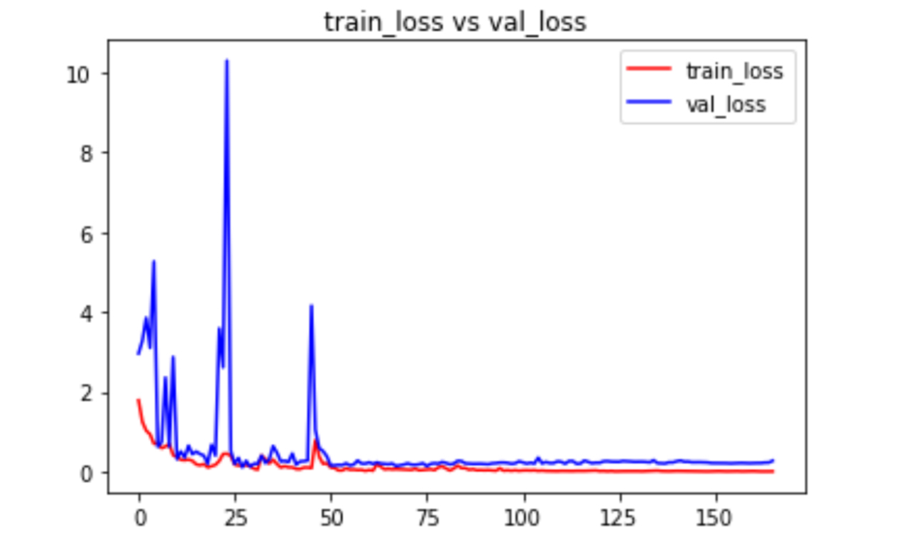
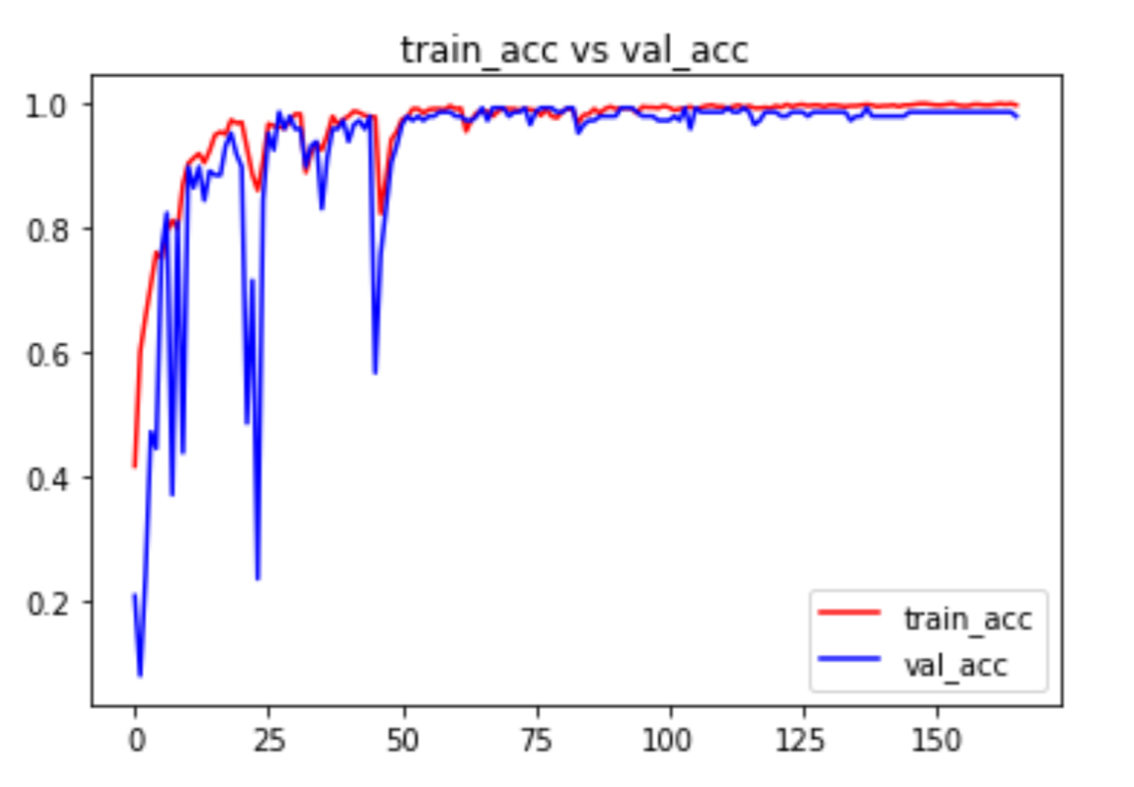
ACCURACY GRAPHS

Slide 10
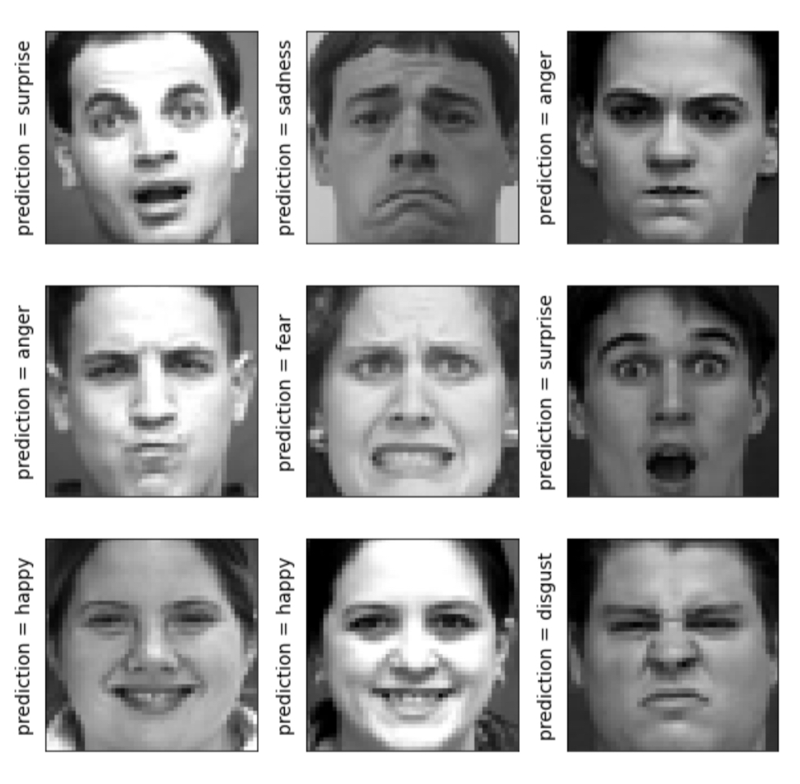
FINAL RESULTS

Slide 11
TEXT RECOGNITION
DATASET USED: GO EMOTION
ACCURACY: 100 %

Slide 12
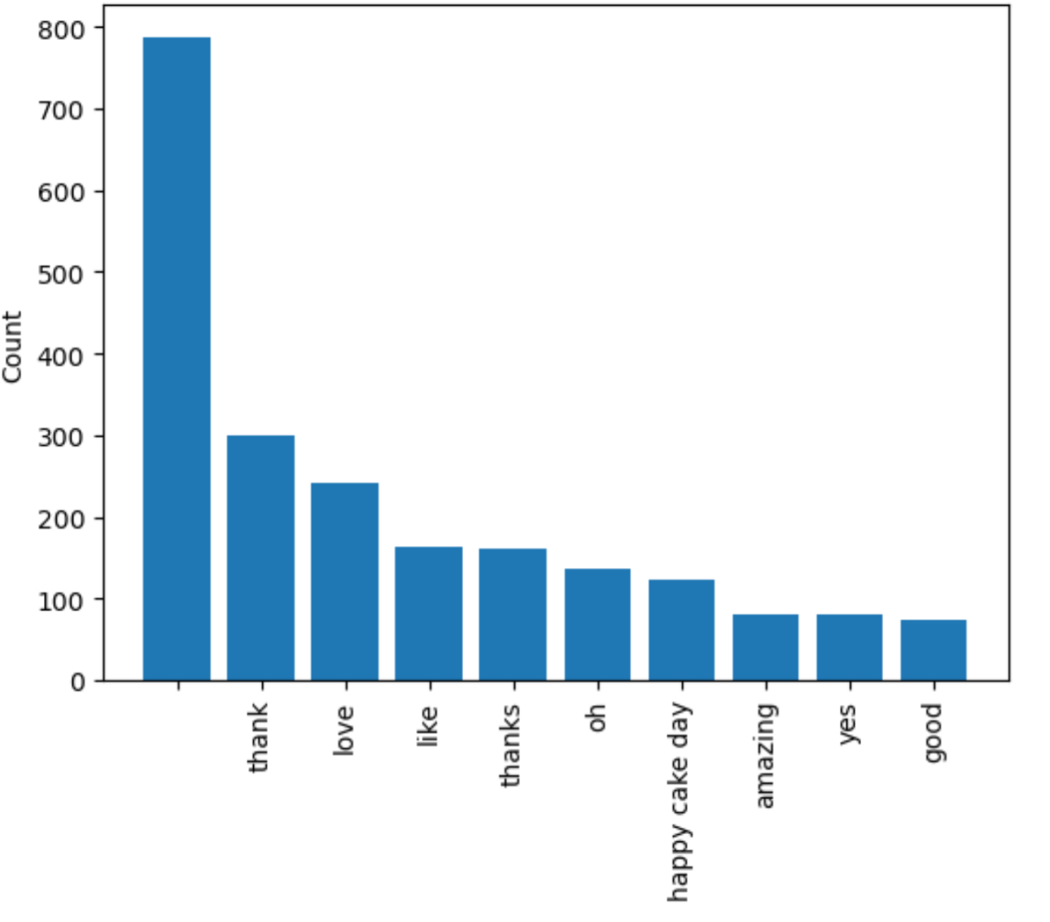
TOP 1O WORD FREQUENCY

Slide 13
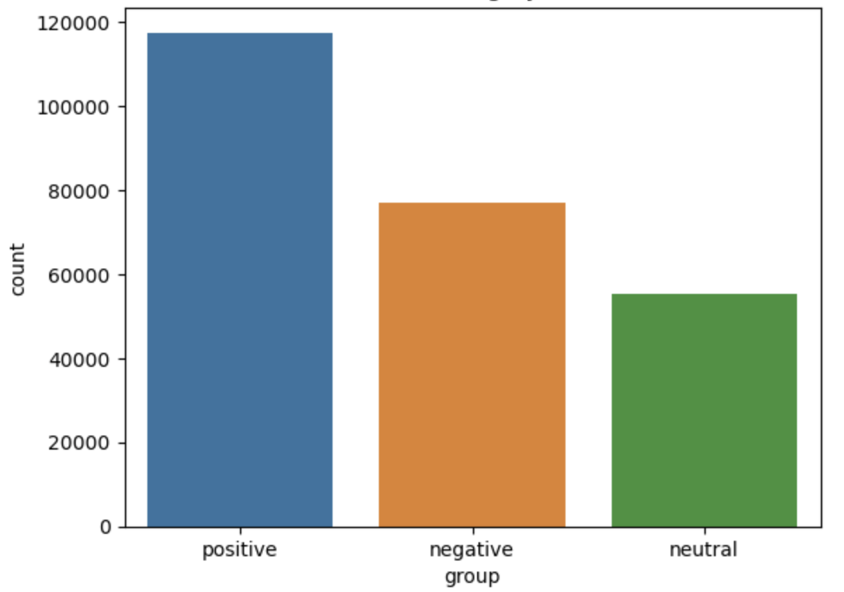
EMOTIONS CATEGORY COUNTS

Slide 14
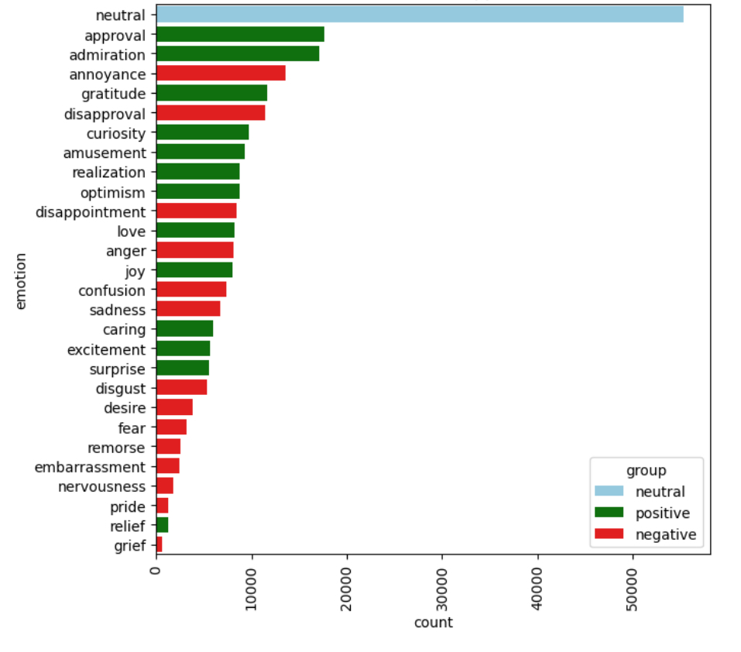
COUNT OF EMOTIONS APPEARANCE

Slide 15
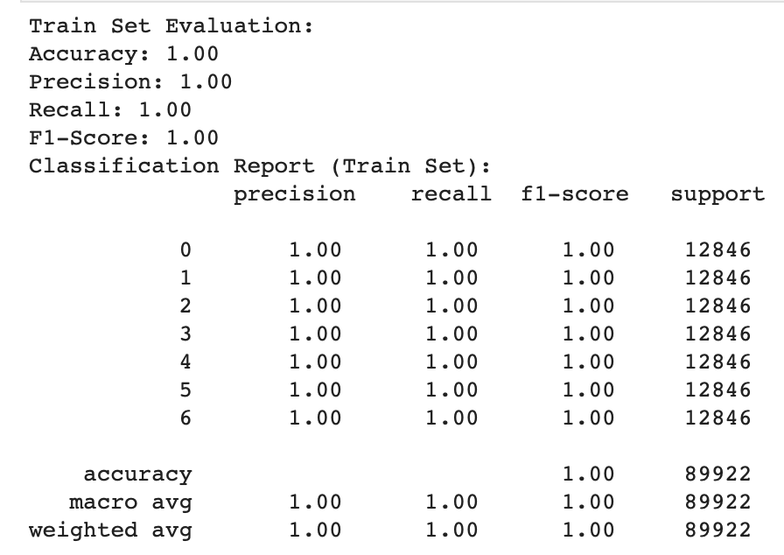
FINAL RESULT

Slide 16
AUDIO RECOGNITION
DATASET USED: RAVDESS
ACCURACY: 81.32 %

Slide 17
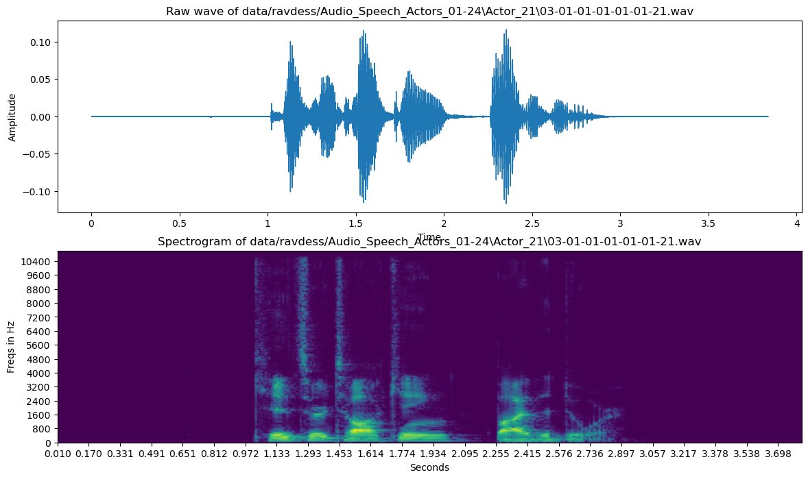
PLOTTING WAVE FORM & SPECTOGRAM

Slide 18
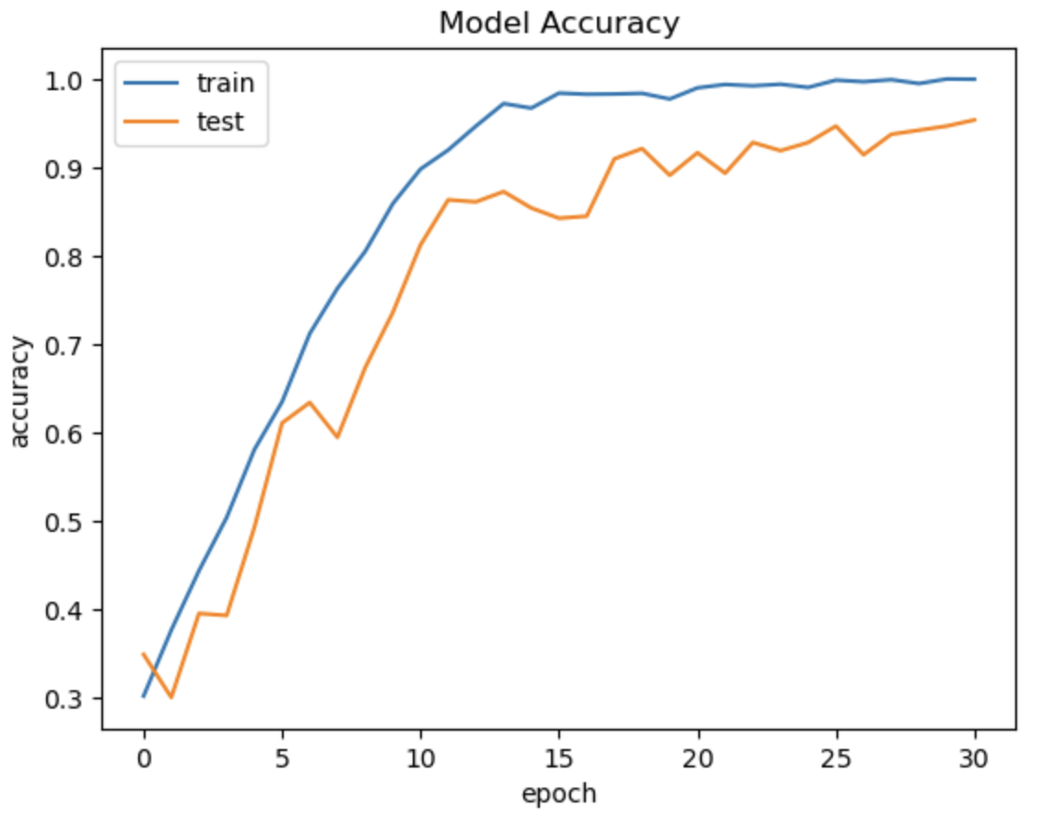
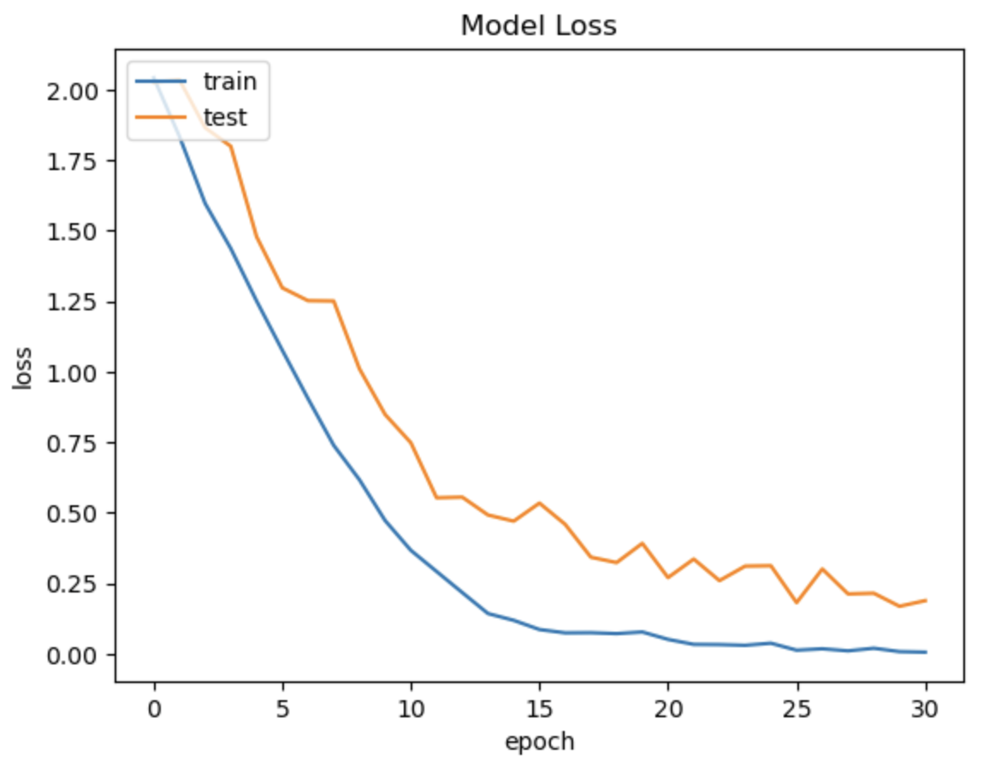
ACCURACY GRAPHS

Slide 19
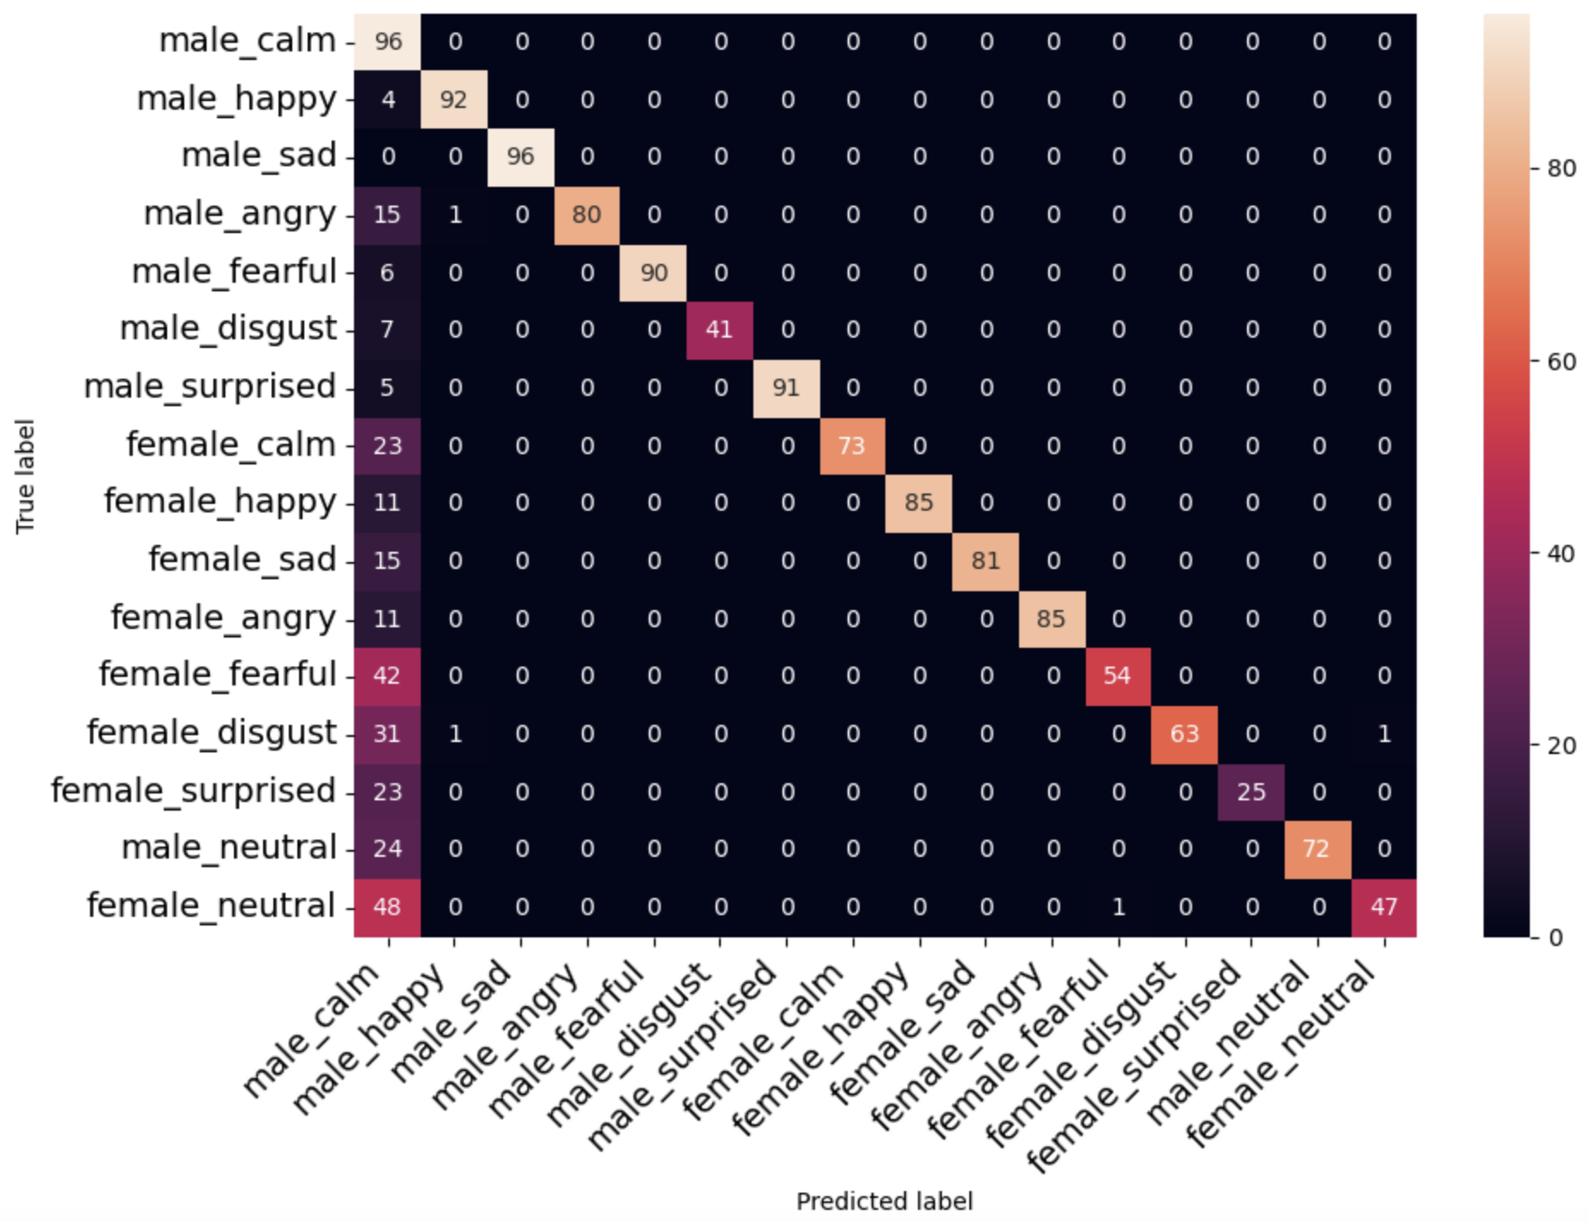
CONFUSION MATRIX

Slide 20
RESULTS CONSIDERED
- Performance metrics like accuracy, F1-score
- Performance comparison of models on benchmark datasets
- Discussion of limitations and challenges

Slide 21
Challenges & Future Directions
Data fusion - Developing methods to successfully integrate heterogeneous data types
Dataset limitations - Obtaining large diverse labeled multi-modal datasets
Context modeling - Incorporating context understanding along with low-level signals
Generalizability - Ensuring models work across demographics and situations
Explainability - Understanding model decisions for transparency

Slide 22
APPLICATIONS
- Example real-world applications: chatbots, AI assistants, education, healthcare
- Business opportunities and ethical considerations

Slide 23
CONCLUSION & FUTURE WORK
Multi-modal emotion recognition has promising real-world applications but requires overcoming data and modeling challenges. With advances in deep learning and affective computing, emotion-aware systems could become a reality. A multi-modal approach is key to robust and explainable emotion recognition.
Notes:
Advancements in multi-modal emotion recognition, analyzing text, sound, and video data, are revolutionizing technology by enhancing its sensitivity to human emotions. Despite challenges, improving technology allows for better understanding of emotions, paving the way for supportive systems and mental health assistance. The key lies in integrating text, audio, and video data to create accurate and explanatory emotion-aware systems.

Slide 24
Reference Links
https://viso.ai/deep-learning/visual-emotion-ai-recognition/
https://medium.com/analytics-vidhya/building-a-real-time-emotion-detector-towards-machine-with-e-q-c20b17f89220
https://web.stanford.edu/class/cs231a/prev_projects_2016/emotion-ai-real.pdf
https://seasalt-capstone.carrd.co/
https://philarchive.org/archive/ARURER
https://www.sciencedirect.com/science/article/pii/S235291482030201X
https://www.mdpi.com/1099-4300/25/10/1440 https://www.mdpi.com/1424-8220/21/16/5452 https://www.hindawi.com/journals/mpe/2019/2593036/

